Slide 1
CMSC201
Computer Science I for Majors
Lecture 20 – Dictionaries

Slide 2
Last Class We Covered
Binary numbers
  Conversion
    Decimal to binary
    Binary to decimal
More file I/O practice
#TBT
Boolean Expressions

Slide 3
Any Questions from Last Time?

Slide 4
Today’s Objectives
Learn about the dictionary data type
Construct dictionaries and access entries in those dictionaries
Use methods to manipulate dictionaries
Decide whether a list or a dictionary is an appropriate data structure for a given application

Slide 5
Exercise: Converting
What are the decimal/binary equivalents of…
  0101
  1001
  0100 0110
  151
  227
  68

Slide 6
Organization
Information in a list is organized how?
  By order
Information in a dictionary is organized...
  By association
Python dictionaries associate a set of keys with corresponding data values

Slide 7
Keys and Values
A dictionary is a set of “keys” (terms), each pointing to their own “values” (meanings)
course = {"major" : "CMSC", "number" : 201}
Dictionary name
Key (string)
Value (string)
Key (string)
Value
(int)

Slide 8
Purpose of Dictionaries
Why use a dictionary instead of a list?
Dictionaries are association based
  It’s very easy (and quick!) to find something
  if you know the key
No matter how big the dictionary is, it can
find any entry almost instantaneously
  Lists would require iterating over
  the list until the item is found

Slide 9
Dictionary Keys
Think of a dictionary as an unordered
set of key:value pairs
Dictionary keys must be unique
  A key in a dictionary is like an index in a list
  Python must know exactly which value you want
Keys can be of any data type
  As long as it is immutable

Slide 10
Dictionary Values
Dictionary keys have many rules, but the values do not have many restrictions
They do not have to be unique
  Why?
They can be mutable or immutable
  Why?
We can have duplicate values in a list, but indexes must be unique
Since they don’t need to be unique, we can change them without restriction

Slide 11
Dictionary Usage Example
What if we have a list of every student at UMBC, with all the info represented as a list?
  The first element of the info list is the UMBC ID #
How long would it take to find a specific student?
  If the list is unsorted, a very long time!
  If it’s sorted, resort every time a student is added
Finding a student by ID # in a dictionary,
on the other hand, is very very quick

Slide 12
Hashing
Why are dictionaries so fast?
  Hashing!
Hashing is a way of translating arbitrary
data (like strings or large numbers) into
a smaller set space for ease of use

Slide 13
Hashing
Hashing takes in anything (a string, an int, a float, etc.) and generate a number based on it
  Same result for same input
  Use a number to tell where to store in memory
Given the same input, you get the same number, and can find it again very quickly

Slide 14
Hash Functions
A “magic function” that, given a value,
tells us where it is stored in memory
  If it’s in that location, it’s in the dictionary
  If it’s not in that location, it’s not in the dictionary
This function would have no other purpose
  If we look at the function’s inputs and outputs, they probably won’t “make sense”
  This function is called a hash function because it “makes hash” of its inputs

Slide 15
Hash Example
The AB12345 UMBC student ID number
  Gives 67,600,000 possible combinations
  Making a list of that size wastes a lot of space
    Wouldn’t use even 1% of the list
  Making a dictionary allows us to better store the thousands of students without requiring a massive waste of space

Slide 16
Creating Dictionaries

Slide 17
Creating Dictionaries (Curly Braces)
The empty dictionary is written as two curly braces containing nothing
  dict1 = {}
To create a dictionary, use curly braces, and a colon (:) to separate keys from their value
  dict2 = {"name" : "Maya", "age" : 7}

Slide 18
Creating Dictionaries (From a List)
To cast a list as a dictionary, you use dict()
myPantry = [[5, 'candy'],
[16, 'cookies'],
[2, 'ice cream']]
# cast to a dictionary
myDict = dict(myPantry)
Must be
key, value pairs

Slide 19
Dictionary Operations

Slide 20
Dictionary Operations
Dictionaries are probably most similar to a list
You can do a number of operations:
  Access a key’s value
  Update a key’s value
  Add new key:value pairs
  Delete key:value pairs

Slide 21
Accessing Values
To access dictionary elements, you use the square brackets and the key to obtain its value
  dogBreeds = {"A" : "Akita", "B" : "Basenji",
  "C" : "Chesapeake Bay Retriever"}
  print("dogBreeds at C:", dogBreeds["C"])
  print("dogBreeds at B:", dogBreeds["B"])
  Output:
  dogBreeds at C: Chesapeake Bay Retriever
  dogBreeds at B: Basenji

Slide 22
Updating Values
To update dictionary elements, you use the square brackets and the key to indicate which value you would like to update
  dogBreeds["B"] = "Beagle"
  print(dogBreeds)
  Output:
  {'C': 'Chesapeake Bay Retriever',
  'B': 'Beagle', 'A': 'Akita'}
Why are these out of order?
Dictionaries organize by association, not by order

Slide 23
Adding New Key:Value Pairs
To add new values, we don’t need to use append() – we simply state the key and value we want to use, with square brackets
  dogBreeds["D"] = "Dunker"
  dogBreeds["E"] = "Eurasier"
  print(dogBreeds)
  Output:
  {'C': 'Chesapeake Bay Retriever', 'B': 'Beagle', 'A': 'Akita', 'E': 'Eurasier', 'D': 'Dunker'}

Slide 24
Deleting Key:Value Pairs
Key:value pairs must be deleted together;
you can’t have a key with no value
To delete a key:value, use the del keyword and specify the key you want to delete
  del dogBreeds["D"]
  print(dogBreeds)
  Output:
  {'C': 'Chesapeake Bay Retriever', 'B': 'Beagle', 'A': 'Akita', 'E': 'Eurasier'}

Slide 25
Time for…
LIVECODING!!!

Slide 26
Creating Dictionaries (From Two Lists)
Here we have two lists
  Of the same length
  Contents of each index match up
    (Pratik is Social Work, Amber is Pre-Med, etc.)
  names = ["Pratik", "Amber", "Sam"]
  major = ["Social Work", "Pre-Med", "Art"]
Write the code to create a dictionary from these

Slide 27
Dictionary Methods

Slide 28
Methods
Methods are functions that are specific to a data type (like append() or lower(), etc.)
theDictionary.get(theKey)
  For a key theKey, returns the associated value
  If theKey doesn’t exist, returns None
  Optionally use a second parameter to return
  something other than None if not found
    theDictionary.get(theKey, -1)

Slide 29
Methods
theDictionary.values()
  Returns a “view” of the theDictionary’s values
  Need to cast to a list
theDictionary.keys()
  Returns a “view” of the theDictionary’s keys
  Need to cast to a list
The two lists returned are in the same order
  (Value at index 0 matches key at index 0, etc.)

Slide 30
When to Use Dictionaries
Dictionaries are very useful if you have...
  Data whose order doesn’t matter
  A set of unique keys
    Words for key, definition or translation for value
    Postal abbreviations for key, full state name for value
    Names for key, a list of their game scores for value
  A need to find things easily and quickly
  A need to easily add and remove elements

Slide 31
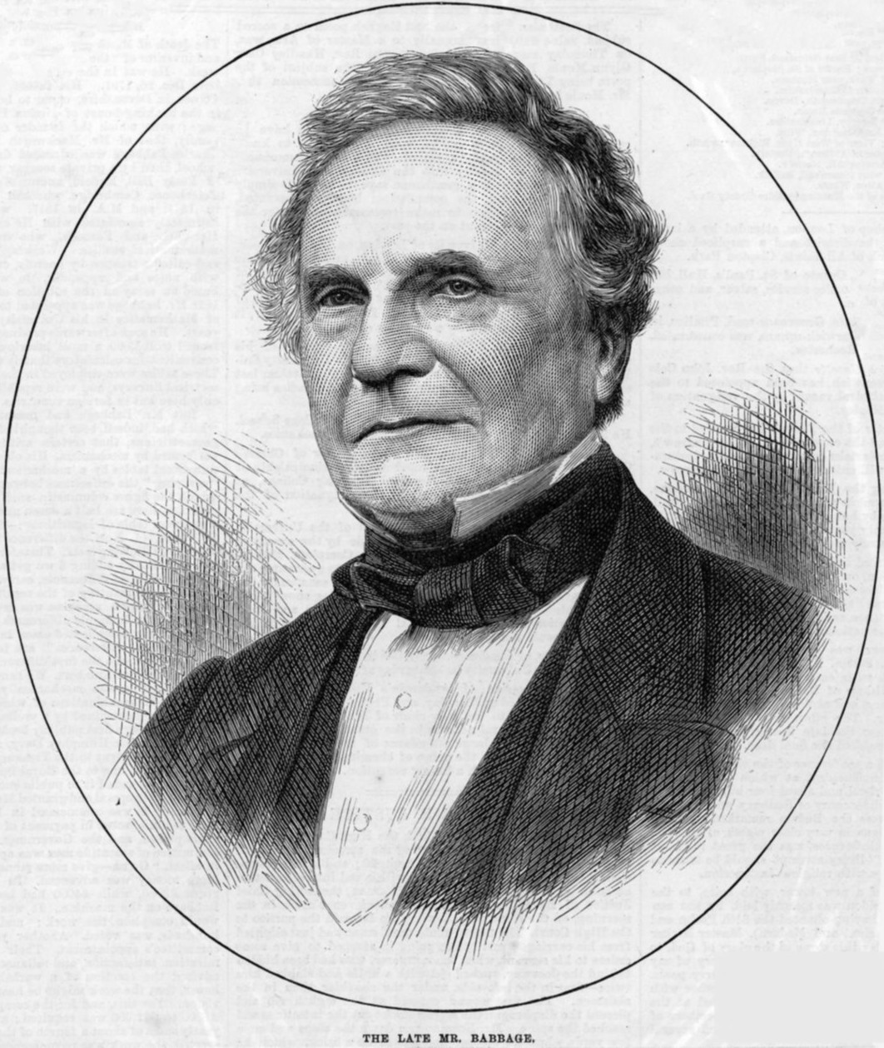
Daily CS History
Charles Babbage
  Invented the Analytical Engine
    Was never built, but would have
    used punched cards to control a
    mechanical calculator
  Work fell into obscurity, and
  computer builders in the 30s
  and 40s re-invented many of
  his architectural innovations
  Also invented the cow catcher for trains

Slide 32
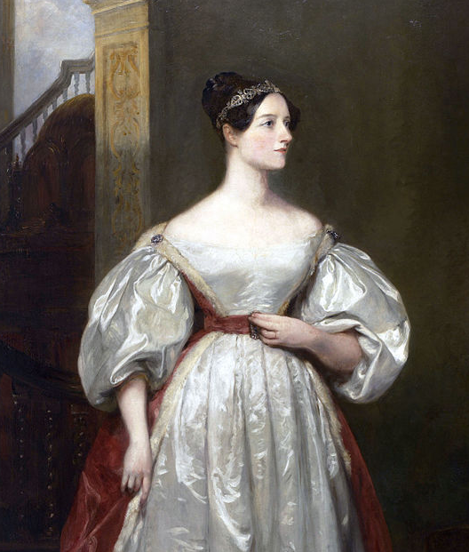
More Daily CS History
Ada Lovelace
  Wrote the first ever computer algorithm
  Realized the potential of the
  Analytical Engine
    If numbers could be used to
    represent other things (like music
    notes), the “engine might compose
    elaborate and scientific pieces of
    music of any degree of complexity
    or extent”

Slide 33
Announcements
Homework 6 is due on Tuesday, Nov 21st
Survey #2 is out and due on Wed, Nov 22nd
No discussion this week (Thanksgiving)
  No lecture on Wednesday
Final exam is when?
Friday, December 15th from 6 to 8 PM

Slide 34
Image Sources
Charles Babbage (adapted from):
  https://commons.wikimedia.org/wiki/File:Charles_Babbage_1860.jpg
Ada Lovelace (adapted from):
  https://commons.wikimedia.org/wiki/File:Ada_Lovelace.jpg

